Slide 1
Arithmetic operators

Slide 2
Outline
In this lesson, we will:
  Define binary arithmetic operators
    Addition, subtraction, multiplication and division
    Integer division
    Remainder/modulus operator
    Upcasting integers to floating-point
  Order of operations
    Upcasting and order of operations
  Unary arithmetic operators
    Negation and “+”

Slide 3
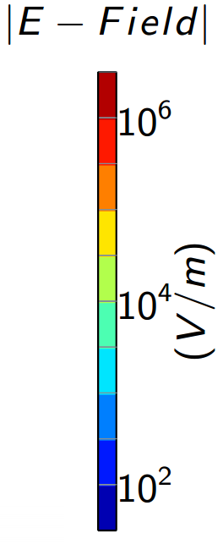
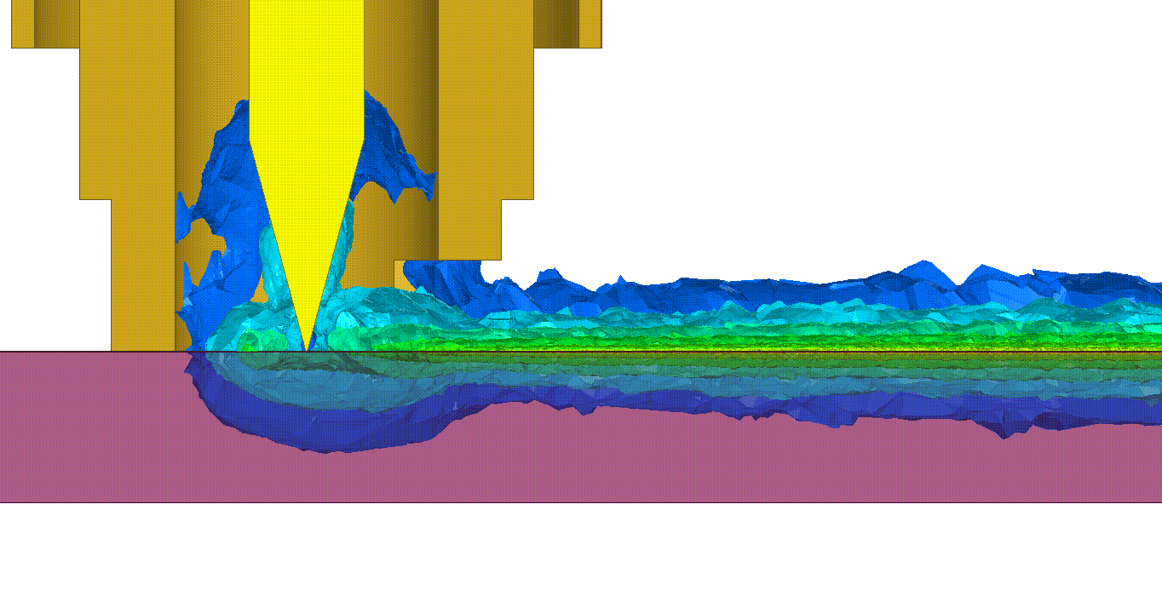
Arithmetic operations
Most engineering computations involve simulations of the real world, requiring the application of mathematics and modelling
  The A380 double-decker jumbo jet was simulated entirely in software prior to being built for the first time…
  Processors and circuits are simulated using mathematical models
Here we see a mathematical model of a quantum socket [1]:

Slide 4
Arithmetic operations
A binary arithmetic operator takes two numerical operands and returns the result of the operation
  The operands may be integers or floating-point
The available binary arithmetic operators are
Operation | Operator | Integers | Floating-point
Addition | + | 3 + 5 | 3.2 + 7.3
Subtraction | – | 7 - 6 | 9.5 - 4.1
Multiplication | × | 8*9 | 1.5*2.7
Division | ÷ | 1/2 | 4.5/9.6
Note: For clarity, it is usual to place spaces around + and -
but no spaces around * or /

Slide 5
Arithmetic operations
Operands can be literal integers and floating-point numbers, as well as identifiers
6.0*width*height PI*radius*radius
Juxtaposition is never acceptable to represent multiplication
If you entered 2xx - 3xy + 4yy, this would result in the compiler signalling an error
  2xx is neither a valid integer, floating-point number or identifier
There is no operator for exponentiation
  Exponentiation requires a function call to a C++ library
2*x*x - 3*x*y + 4*y*y

Slide 6
Order of operations
The compiler uses the same rules you learned from secondary school:
  Multiplication and division before addition and subtraction
    In all cases, going from left to right
Try the following:
std::cout << (1 + 2 + 3 + 4 * 5 * 6 + 7 + 8 + 9);
std::cout << (1 * 2 * 3 + 4 * 5 * 6 + 7 + 8 + 9);
std::cout << (1 * 2 * 3 * 4 * 5 + 6 + 7 + 8 + 9);
std::cout << (1 * 2 * 3 * 4 * 5 - 6 * 7 + 8 * 9);

Slide 7
Order of operations
Parentheses can be used to enforce the order in which operations are performed
Common mistakes include
k/m*n when they mean k/(m*n) or k/m/n
k/m+n when they mean k/(m + n)
k+m/n when they mean (k + m)/n

Slide 8
Integer division
In C++, the result of an arithmetic operation on integers must produce an integer
  This is a problem for division
std::cout << (1/2); // outputs 0
std::cout << (7/3); // outputs 2
std::cout << (-11/4); // outputs -2
std::cout << (-175/-13); // outputs 13
The result is the quotient discarding any remainder

Slide 9
Order of operations
Here are some further examples that depend on integer division:
std::cout << (1 / 2 + 3 * 4 + 5 * 6 * 7 - 8 * 9);
std::cout << (1 + 2 * 3 * 4 / 5 * 6 * 7 * 8 / 9);
std::cout << (1 * 2 + 3 + 4 * 5 * 6 / 7 * 8 + 9);
For example:
(1 / 2) + (3 * 4) + (5 * 6 * 7) - (8 * 9)
0 + 12 + 210 - 72 = 150

Slide 10
Integer remainder
To find the remainder of a division, use the modulus operator
  Also called the remainder operator
std::cout << (1 % 2); // outputs 1
std::cout << std::endl;
std::cout << (7 % 3); // outputs 1
std::cout << std::endl;
std::cout << (-11 % 4); // outputs -3
std::cout << std::endl;
std::cout << (-175 % -13); // outputs -6
std::cout << std::endl;
For any integers m and n, it is always true that
(n/m)*m + (n % m) equals n

Slide 11
Integer remainder
Let’s take a closer look at:
(n/m)*m + (n % m)
Don’t we know from mathematics that as long as m ≠ 0,
C++ evaluates one expression at a time
  If the compiler sees (7/3)*3,
    It first will have (7/3) calculated, which evaluates to 2
    It then proceeds to calculate 2*3 which is 6
?

Slide 12
Spacing around operators
In C++, you can put any amount of whitespace between operators and their operands:
    std::cout << ((n/m)*m + (n % m));
    std::cout << ((n/m)*m+(n%m));
    std::cout <<
    ( ( n
    / m )* m +
    ( n% m ))
    ;
We recommend:
  Putting one space between operands and +, - and %
  Juxtaposing operands with * and / operands
Forcing your self soon makes it habitual
  You will not even think about it when you type…

Slide 13
Upcasting
Suppose the compiler sees:
3.2/2
Does it use floating-point division, or integer division?
  The only way for this to make sense is for the compiler to interpret the 2 as a floating-point number
  This process is called upcasting
    Literals are upcast by the compiler

Slide 14
Order of operations and upcasting
Again, C++ is very exact when upcasting occurs:
  Only when one operand is a floating-point number and the other is an integer is the integer upcast to a floating-point number
What is the output of each of the following? Why?
std::cout << (10.0 + (1 / 2) * 3.0);
std::cout << (10.0 + 1 / 2 * 3.0);
std::cout << (10.0 + 1 / (2 / 3.0));

Slide 15
Unary operators
There are two unary operators for arithmetic:
  Unary negation operator changes the sign of what follows:
std::cout << -(1 + 2 + 3);
std::cout << -(2*3*4);
std::cout << -(1 + 2*3);
  Unary neutral operator leaves the sign unchanged:
std::cout << +(1 + 2 - 5);
std::cout << +(-2*3*4);
std::cout << +(1 - 2*3);

Slide 16
Arithmetic expression
If all of the variables are int, the result of these is an int:
    35
    a
    a + b + c + d + 1
    12*(a + b)*(1 - b)
    (a + b + c)/10;
    (a - 1)*a*(a + 1)
    -a + b
    +c
If all of the variables are double, the result of these is a double:
    35.0
    a
    a + b + c + d + 1.3
    12.5*(a + b)*(1.0 - b)
    (a + b + c)/10.5;
    (a – 1.7)*a*(a + 1.7)
    -a + b
    +c

Slide 17
Arithmetic expression
We can now make the following statements:
  An integer arithmetic expression will always evaluate to an integer
We can make an identical description of floating-point arithmetic expressions

Slide 18
Summary
Following this presentation, you now:
  Understand the binary arithmetic operators in C++
    Addition, subtraction, multiplication and division
  The effect of integer division and the remainder operator
  Upcasting integers to floating-point
  Understand the order of operations and upcasting
  The two unary arithmetic operators

Slide 19
References
[1] Thomas McConkey, a simulation of a 6 GHz microwave signal transmitting through a coaxial pogo pin onto a micro-coplanar waveguide transmission line of a thin film superconducting aluminium (i.e., a quantum socket). Developed with the Ansys software hfss.
[2] Wikipedia, https://en.wikipedia.org/wiki/Operators_in_C_and_C++#Arithmetic_operators
[3] cplusplus.com tutorial,
http://www.cplusplus.com/doc/tutorial/operators/
[4] C++ reference,
https://en.cppreference.com/w/cpp/language/operator_arithmetic

Slide 20
Acknowledgments
Proof read by Dr. Thomas McConkey and Charlie Liu.

Slide 21



Colophon
These slides were prepared using the Georgia typeface. Mathematical equations use Times New Roman, and source code is presented using Consolas.
The photographs of lilacs in bloom appearing on the title slide and accenting the top of each other slide were taken at the Royal Botanical Gardens on May 27, 2018 by Douglas Wilhelm Harder. Please see
https://www.rbg.ca/
for more information.

Slide 22
Disclaimer
These slides are provided for the ece 150 Fundamentals of Programming course taught at the University of Waterloo. The material in it reflects the authors’ best judgment in light of the information available to them at the time of preparation. Any reliance on these course slides by any party for any other purpose are the responsibility of such parties. The authors accept no responsibility for damages, if any, suffered by any party as a result of decisions made or actions based on these course slides for any other purpose than that for which it was intended.

